Slide 1

2022 Data Insights and Business Strategy Plan
By Alex Sheardown
4/7/2023

Slide 2

Overview
Our analysis is based on data from CSV files containing information on:
Installs
Ads
Revenue
Payouts
Notes:
This file is good come back to make more specific.

Slide 3
General KPIs for 2022
New installations
216887
Profit generated by Apps
418845.25
Dollars spent on Adds
254,075.98

Slide 4
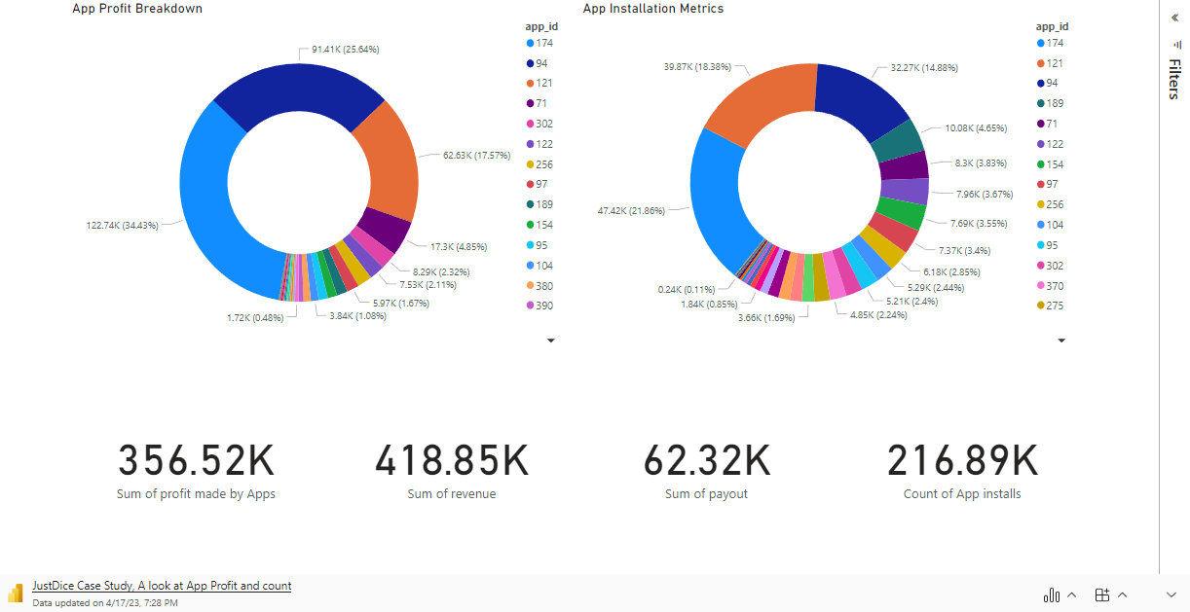
Summary From App data

Slide 5
Breaking Down App Data
Key Insights:
There are 51 apps in total
The top 3 apps generate 77% of profit
The top 3 apps also account for 55% of downloads
Implications :
Monitoring and optimizing these top apps is crucial to company growth
Opportunities exist to promote other high-potential apps

Slide 6

Potential Next Step form Dashboard (1)
Analyze the performance of the other 48 apps to identify reasons for low profitability
Determine whether to allocate more resources to improve these apps or phase them out
Conduct user research to understand the needs and preferences of users
Develop and test new apps that align with user needs and show potential for profitability.

Slide 7
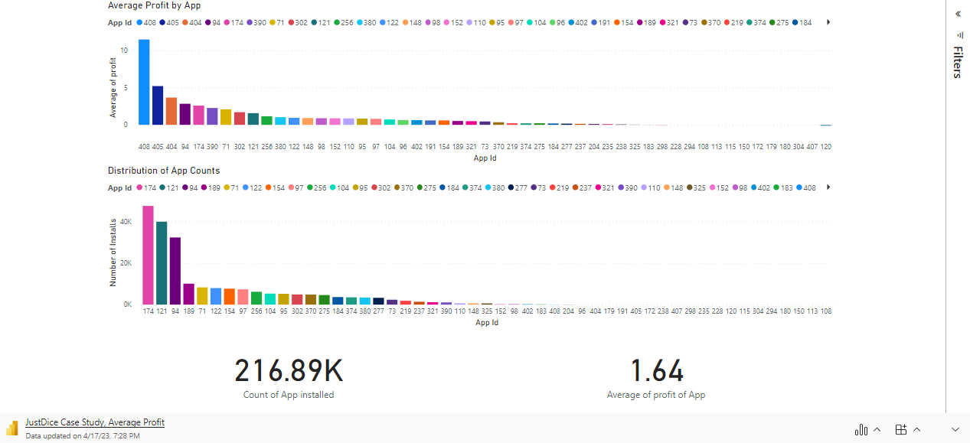
Average Profit by App Dashboard (2)

Slide 8
High Profitability of Top 3 Apps Despite Low Download Count
Key insights:
The 3 highest on average profit apps have an average profit of 10.47.
These apps have less than 1% of total app downloads.
Implications:
While these apps may have a small number of installs, their high profitability suggests that they could be a lucrative area of focus for further development and marketing efforts.

Slide 9
Potential Next Step from Dashboard (2)
Consider allocating resources towards the development and marketing of similar high-profit apps with a smaller user base.
Investigate the reasons behind the high profitability of these apps and determine if their success can be replicated in other areas.

Slide 10
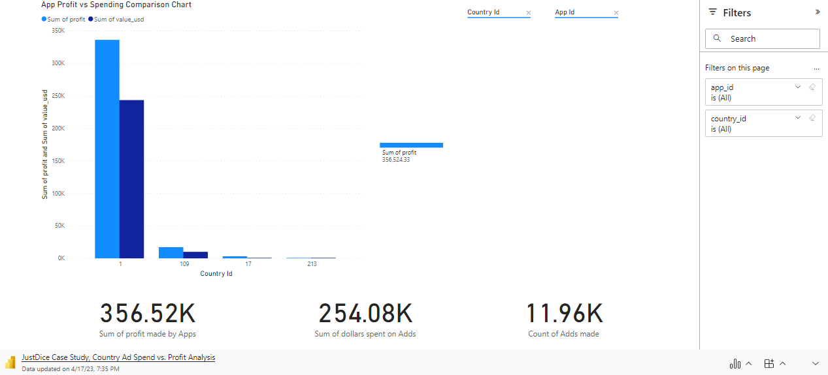
App Profit vs Add Spending Comparison (3)

Slide 11
Key Insights on App Performance by Country
Key insights:
One country takes 95 percent of all add revenue and generates 94 percent add profit.
Two countries have a significantly higher return rates than the rest, with two countries standing out with rates of 1.7 and 9
The top profit apps per country show that there is a regional difference between what apps are popular.
Implications:
Targeted marketing efforts in the leading market could significantly boost revenue and profit.
Countries with a high return rate present an opportunity for growth and expansion.
Developing and promoting localized apps can better meet the preferences and needs of users in different countries.

Slide 12
Potential Next Step from Dashboard (3)
Conduct a comprehensive analysis of the targeted market to understand user behavior, preferences, and trends.
Develop targeted marketing and promotion strategies for the high return rate countries to maximize user engagement and revenue generation.
Invest in localized app development and promotion efforts to expand the user base in different regions and increase profitability.

Slide 13

Summary
Strong performance with $164,769.27 profit after ad spending.
There is promising growth opportunities in high return rate countries and localized apps.
We have found our top-performing apps are key to future success.

